Slide 1
Debug V2
2024.3.21

Slide 2
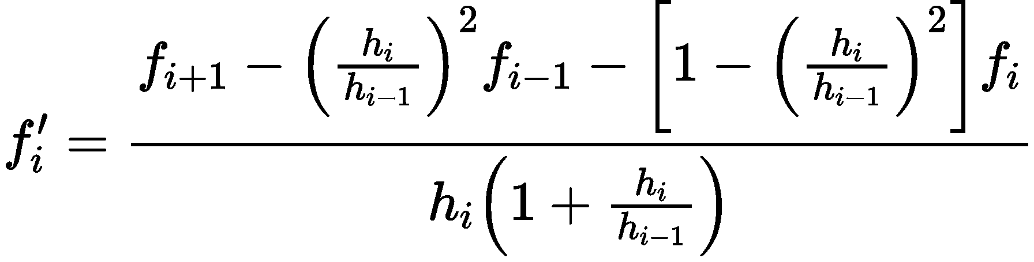
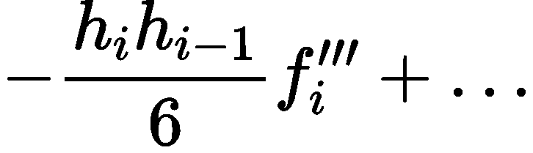
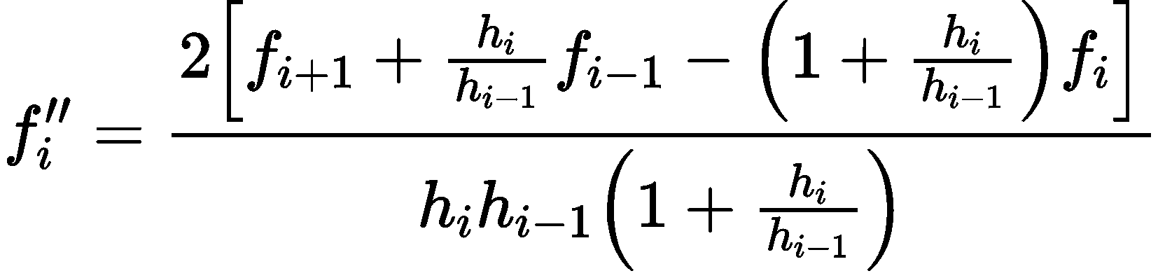
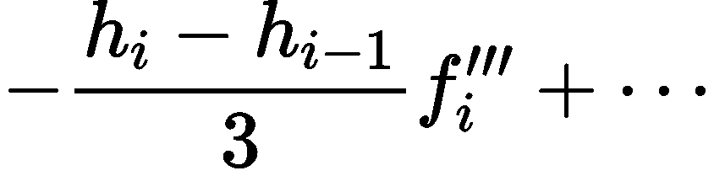
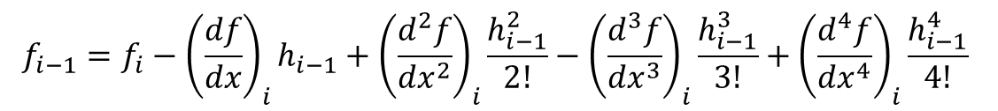
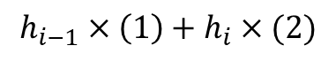
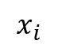
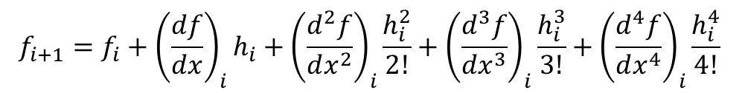
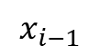
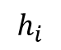
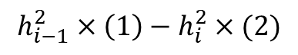
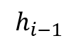
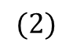
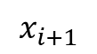
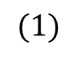
非均匀网格中心差分
$$f_{i+1}=f_{i}+{\left(\frac{df}{dx}\right)}_{i}h_{i}+{\left(\frac{d^{2}f}{dx^{2}}\right)}_{i}\frac{h_{i}^{2}}{2!}+{\left(\frac{d^{3}f}{dx^{3}}\right)}_{i}\frac{h_{i}^{3}}{3!}+{\left(\frac{d^{4}f}{dx^{4}}\right)}_{i}\frac{h_{i}^{4}}{4!}$$
$$h_{i−1}$$
$$h_{i}$$
$$(1)$$
$$x_{i−1}$$
$$x_{i}$$
$$x_{i+1}$$
$$f_{i−1}=f_{i}−{\left(\frac{df}{dx}\right)}_{i}h_{i−1}+{\left(\frac{d^{2}f}{dx^{2}}\right)}_{i}\frac{h_{i−1}^{2}}{2!}−{\left(\frac{d^{3}f}{dx^{3}}\right)}_{i}\frac{h_{i−1}^{3}}{3!}+{\left(\frac{d^{4}f}{dx^{4}}\right)}_{i}\frac{h_{i−1}^{4}}{4!}$$
$$(2)$$
$$h_{i−1}^{2}×\left(1\right)−h_{i}^{2}×(2)$$
$$h_{i−1}×\left(1\right)+h_{i}×(2)$$

Slide 3
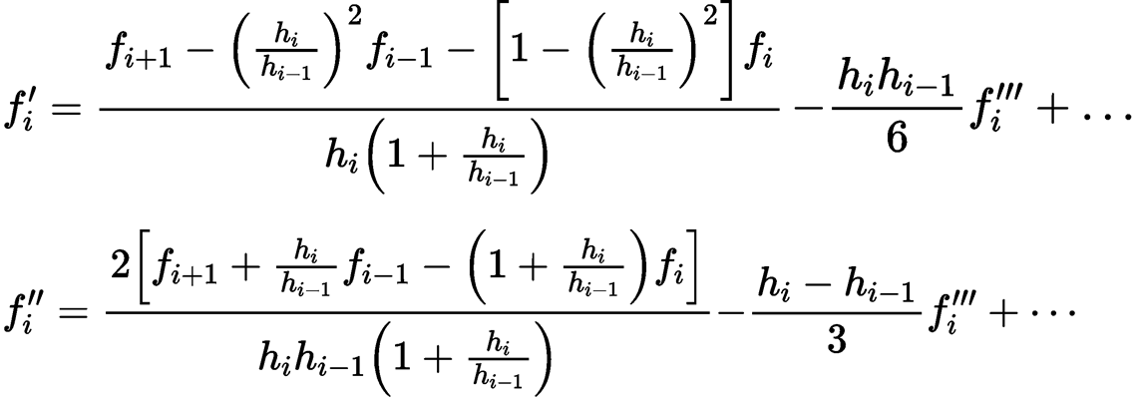
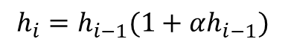
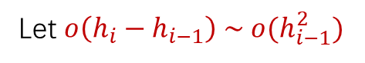

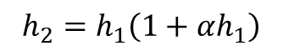
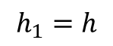
非均匀网格中心差分的阶数问题
合理选择非均匀网格的增长性质
Let $o\left(h_{i}−h_{i−1}\right) \sim o(h_{i−1}^{2})$
$$h_{1}=h$$
$$h_{2}=h_{1}\left(1+αh_{1}\right)$$
$$⋮$$
$$h_{i}=h_{i−1}(1+αh_{i−1})$$

Slide 4
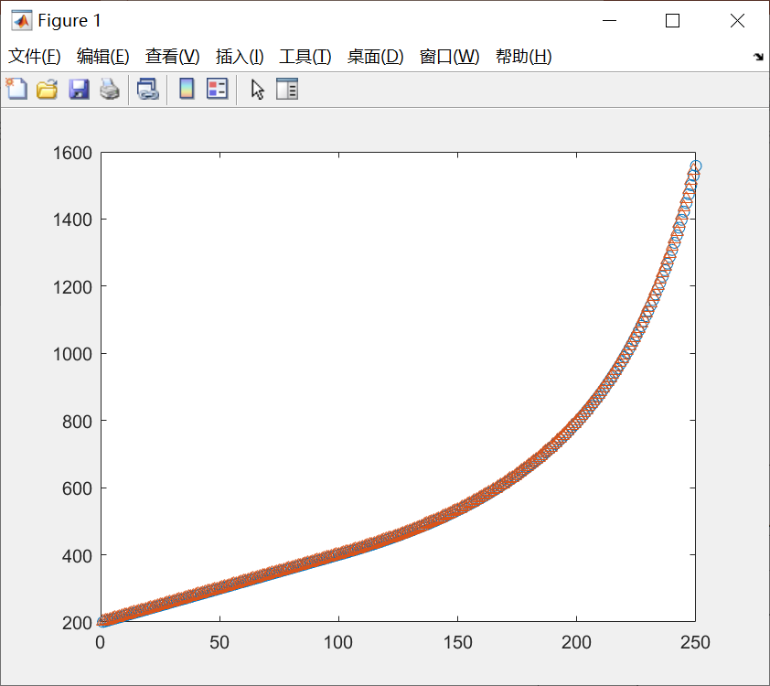
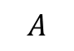
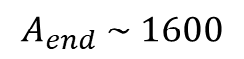

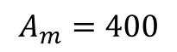
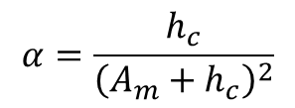
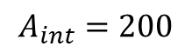
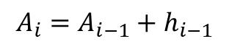
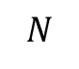
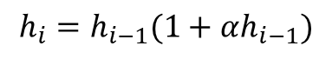
$$α=\frac{h_{c}}{{\left(A_{m}+h_{c}\right)}^{2}}$$
$$h_{i}=h_{i−1}(1+αh_{i−1})$$
Mesh points $A$
$$A_{i}=A_{i−1}+h_{i−1}$$
$$A_{end} \sim 1600$$
$$A$$
$$A_{m}=400$$
$$A_{int}=200$$
$$N$$

Slide 5
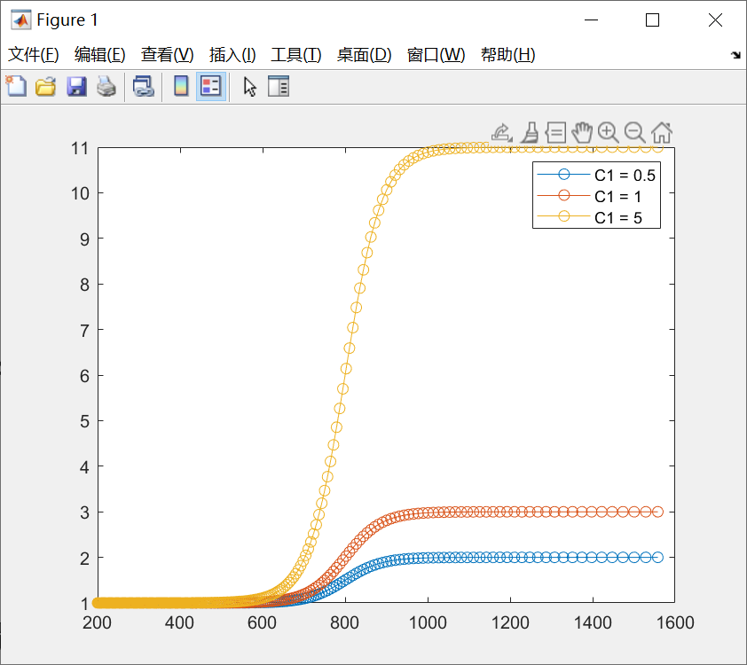
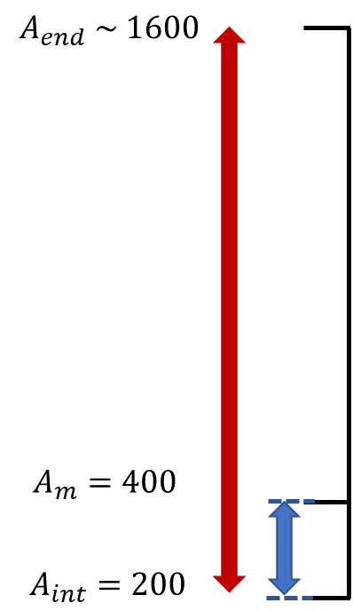
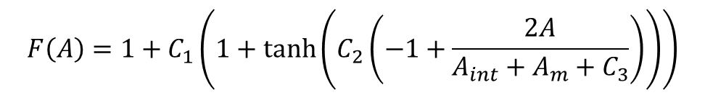


黏性修正函数$F(A)$设置
$$F\left(A\right)=1+C_{1}\left(1+\tanh\left(C_{2}\left(−1+\frac{2A}{A_{int}+A_{m}+C_{3}}\right)\right)\right)$$
$C_{1}$控制光滑函数的上界

Slide 6
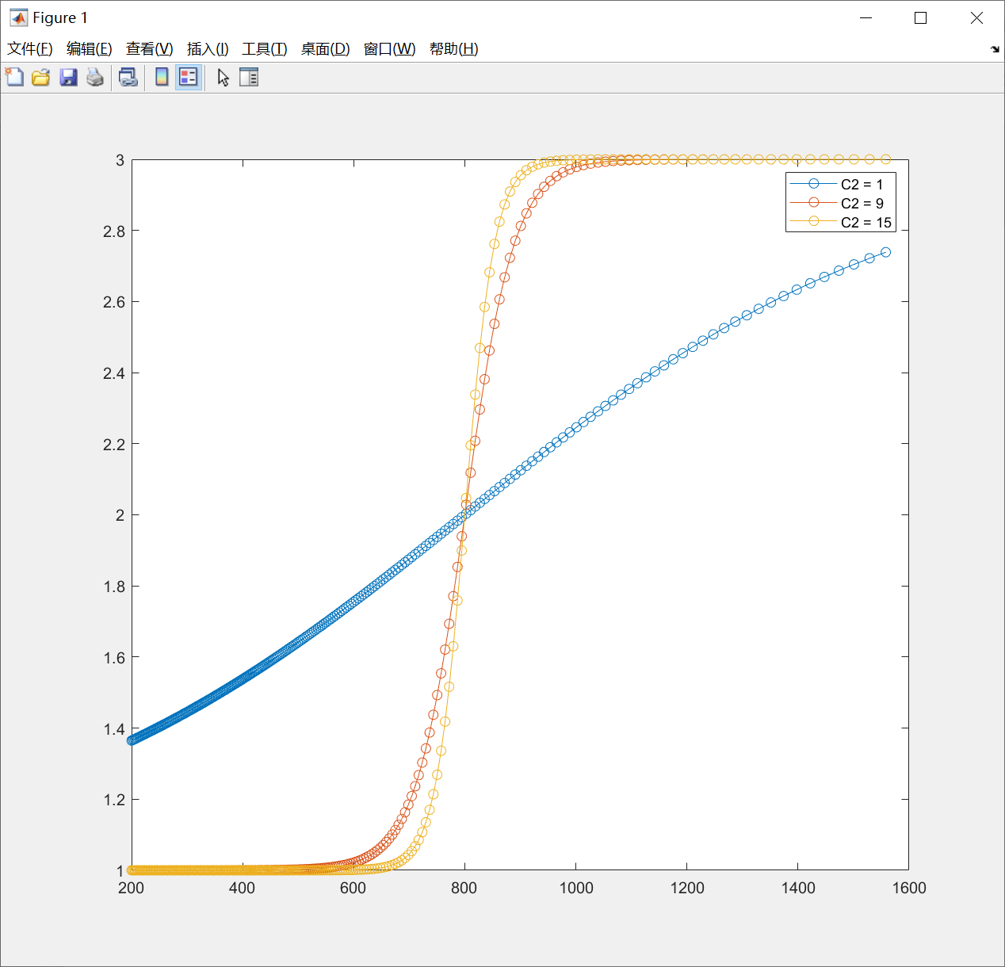
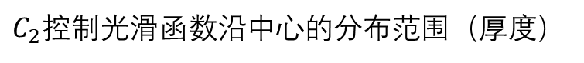
黏性修正函数$F(A)$设置
$$F\left(A\right)=1+C_{1}\left(1+\tanh\left(C_{2}\left(−1+\frac{2A}{A_{int}+A_{m}+C_{3}}\right)\right)\right)$$
$C_{2}$控制光滑函数沿中心的分布范围（厚度）

Slide 7
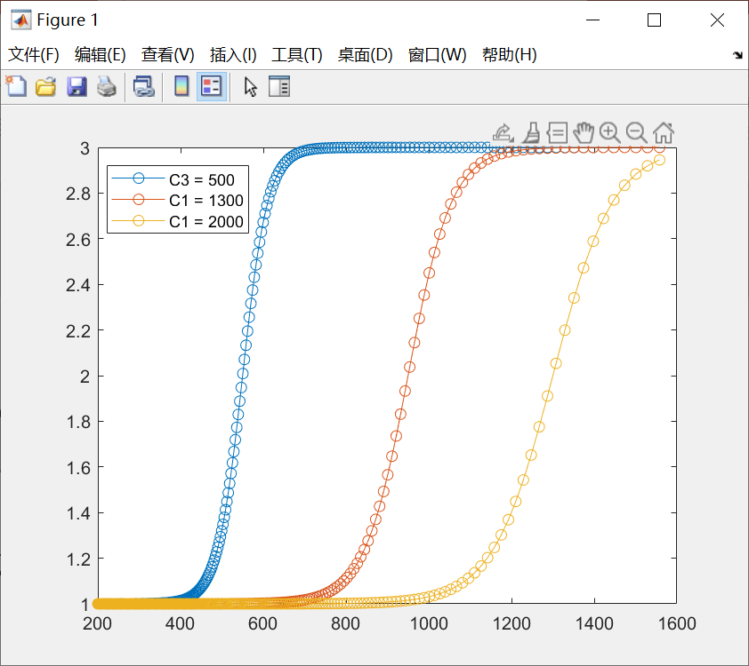
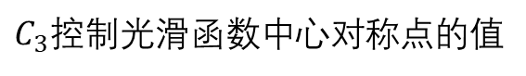
黏性修正函数$F(A)$设置
$$F\left(A\right)=1+C_{1}\left(1+\tanh\left(C_{2}\left(−1+\frac{2A}{A_{int}+A_{m}+C_{3}}\right)\right)\right)$$
$C_{3}$控制光滑函数中心对称点的值

Slide 8
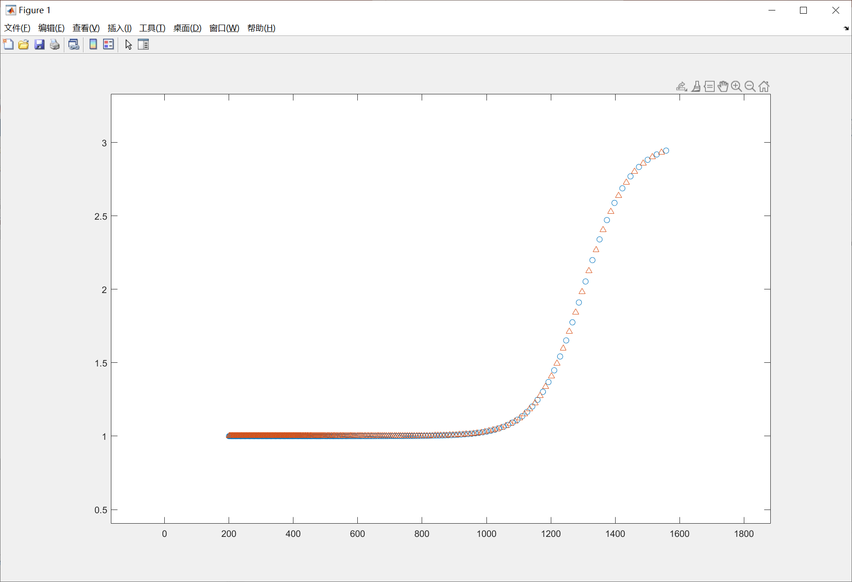
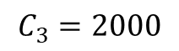
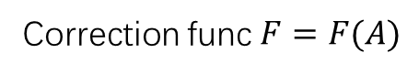
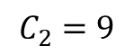
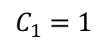
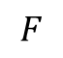

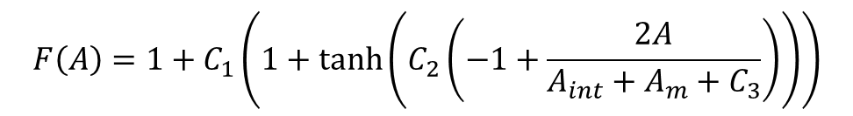
Correction func $F=F(A)$
$$F\left(A\right)=1+C_{1}\left(1+\tanh\left(C_{2}\left(−1+\frac{2A}{A_{int}+A_{m}+C_{3}}\right)\right)\right)$$
$$C_{1}=1$$
$$C_{2}=9$$
$$C_{3}=2000$$
$$F$$
$$A$$

Slide 9
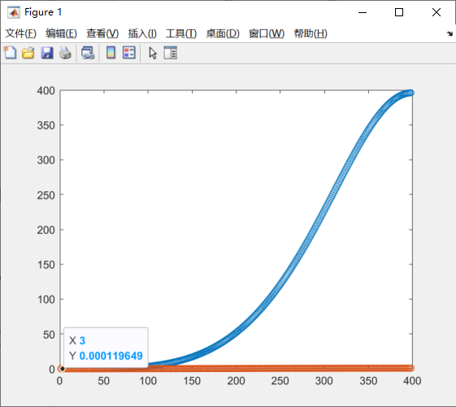
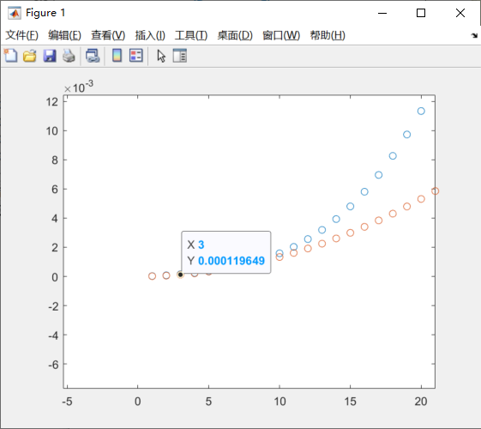
橙色：均匀网格的特征值
蓝色：逐渐变粗网格的特征值

Slide 10
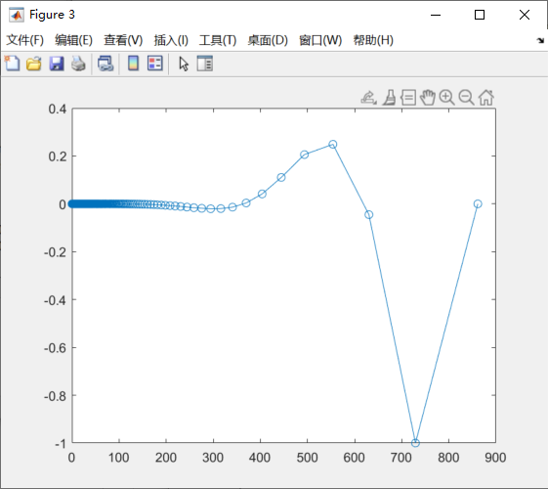
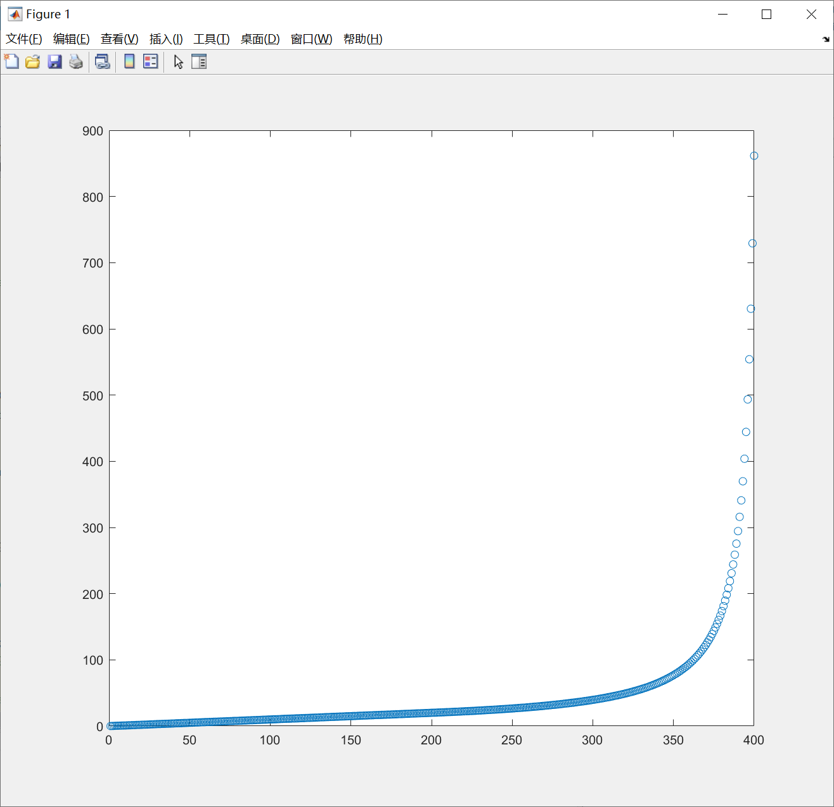
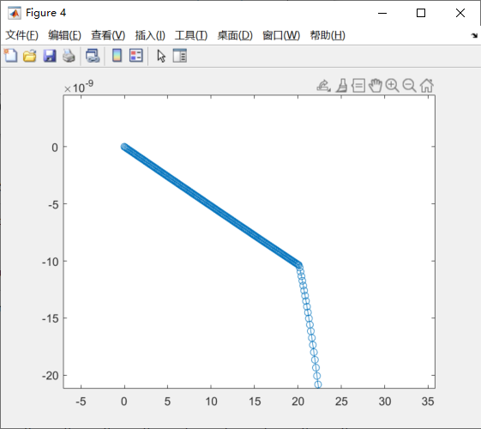
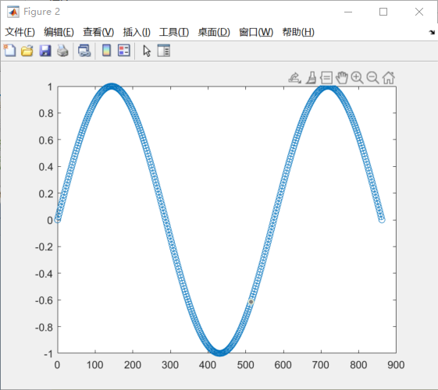
变疏网格

Slide 11
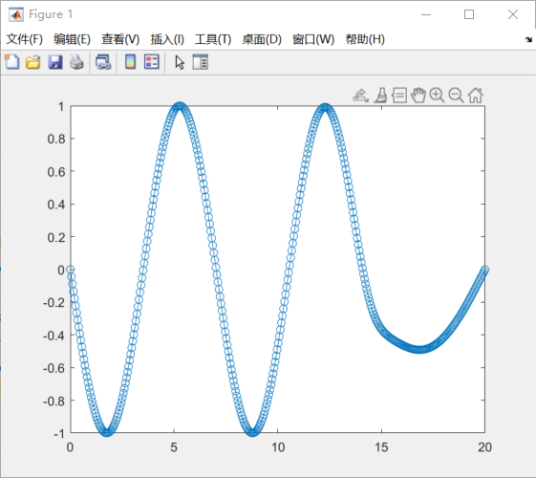


调整FA

Slide 12


加密网格

Slide 13





$$FA∗y^{′′}=−ky$$
$$\frac{1}{h^{2}}→\frac{1}{λ^{2}h^{2}}$$
$λ$ decrease
$FA$ increase
$y_{i+1}−y_{i}也$减小了而且可能减小的更快

Slide 14

格点法调整网格

Slide 15



Slide 16


Slide 17


Slide 18


Slide 19










$$−iωH+\frac{dH}{dA}+\frac{dU}{dA}+i\frac{k_{2}}{A\cos{ξ}}V=0$$
$$−iωU+C\frac{dU}{dA}=−\frac{1}{Fr^{2}}\frac{dH}{dA}+\frac{1}{Re}\frac{d^{2}U}{dA^{2}}−\frac{1}{Re}{\left(\frac{k_{2}}{A\cos{ξ}}\right)}^{2}U−\frac{1}{Re}3U+\frac{1}{Re}6H$$
$$−iωV+\frac{dV}{dA}=−\frac{1}{Fr^{2}}\frac{ik_{2}}{A\cos{ξ}}H +\frac{1}{Re}\frac{d^{2}V}{dA^{2}}−\frac{1}{Re}{\left(\frac{k_{2}}{A\cos{ξ}}\right)}^{2}V−\frac{1}{Re}3V$$
$$\left(−\frac{1}{2h}\right)H_{j−\frac{3}{2}}+\left(−\frac{1}{h}\right)U_{j−1}+\left(\frac{1}{2}i\frac{k_{2}}{A_{j−\frac{1}{2}}\cos{ξ}}\right)V_{j−1}+\left(\frac{1}{h}\right)U_{j}+\left(\frac{1}{2}i\frac{k_{2}}{A_{j−\frac{1}{2}}\cos{ξ}}\right)V_{j}+\left(\frac{1}{2h}\right)H_{j+\frac{1}{2}}=iωH_{j−\frac{1}{2}}$$
$$\left(−\frac{1}{2h}−\frac{1}{Rh^{2}}\right)U_{j−1}+\left(−\frac{3}{R}−\frac{1}{F^{2}h}\right)H_{j−\frac{1}{2}}+\left(\frac{2}{Rh^{2}}+\frac{3}{R}\right)U_{j}+\left(−\frac{3}{R}+\frac{1}{F^{2}h}\right)H_{j+\frac{1}{2}}+\left(\frac{1}{2h}−\frac{1}{Rh^{2}}\right)U_{j+1}=iωU_{j}$$
$$\left(−\frac{1}{2h}−\frac{1}{Rh^{2}}\right)V_{j−1}+\left(\frac{1}{2}\frac{1}{F^{2}}\frac{ik_{2}}{A_{j}\cos{ξ}}\right)H_{j−\frac{1}{2}}+\left(\frac{2}{Rh^{2}}+\frac{3}{R}\right)V_{j}+\left(\frac{1}{2}\frac{1}{F^{2}}\frac{ik_{2}}{A_{j}\cos{ξ}}\right)H_{j+\frac{1}{2}}+\left(\frac{1}{2h}−\frac{1}{Rh^{2}}\right)V_{j+1}=iωV_{j}$$
$$j−\frac{2}{3}$$
$$j−\frac{1}{2}$$
$$j+\frac{1}{2}$$
$$j+\frac{2}{3}$$
$$j−1$$
$$j$$
$$j+1$$

Slide 20

B.C. du=0

Slide 21

B.C. Du=0

Slide 22


Slide 23

Mesh range 1000->2000

Slide 24

Mesh points 846->405

Slide 25


Slide 26

调大流量：扰动增强

Slide 27

Blue: D2x=0
Yellow: Dx=0

Slide 28


Slide 29

边界条件
Dh=0
dh=0
Du=0
Du=0
h=0
du=0
du=0
u=0
du=0

Slide 30


Slide 31







参数
$$g=9.8$$
$$a_{int}=1000∗r_{int}$$
$$r_{int}=2.5×{10}^{−3}$$
$$ν=5×{10}^{−5}$$
$$ξ=20°$$
$$q_{0}=3×{10}^{−5}/2π$$
$$c_{2}=3$$

Slide 32


Slide 33



Slide 34
Appendix

Slide 35


With FA*Gamp terms
818

Slide 36







Mesh points $A$
Correction func $F=F(A)$
$$A$$
$$F$$
$$N$$
$$A$$

Slide 37









非均匀网格中心差分
$$h_{j−1}$$
$$h_{j}$$
$$x_{j−1}$$
$$x_{j}$$
$$x_{j+1}$$
Hilding Sundqvist & George Veronis (1970) A simple finite-difference grid with non-constant intervals, Tellus, 22:1, 26-31, DOI: 10.3402/tellusa.v22i1.10155

Slide 38


非均匀网格中心差分的阶数问题
Let $o\left(h_{i}−h_{i−1}\right) \sim o(h_{i−1}^{2})$
合理选择非均匀网格的增长性质

Slide 39


